Slide 1
Array

Slide 2
How to store math marks for all Students?
Suppose we have 10 students.
So, we have to keep in mind two things-
Roll of a student
Mark of that student
So, we need 10 variable to store marks –
roll_1, roll_2,........., roll_10
What will happen if we have 100 students? [example]

Slide 3
Array
In C, an array is a list of variables that are all of the same type and are accessed through a common name.
An individual variable in the array is called an array element.
It is useful to handle groups of related data.

Slide 4
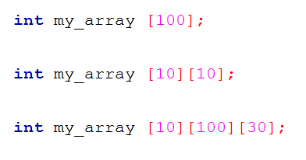
Types of Array
One dimensional Array
Multi dimensional Array

Slide 5
One Dimensional Array….
General form-
type is a valid C data type.
var_name is the name of the array
size specifies the number of elements in the array
type var_name[size]
Type
Array name
Size – can hold 100 elements

Slide 6

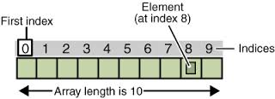
One Dimensional Array….
An array element is accessed by indexing the array using the number of the element.
In C, all arrays begin at zero.

Slide 7
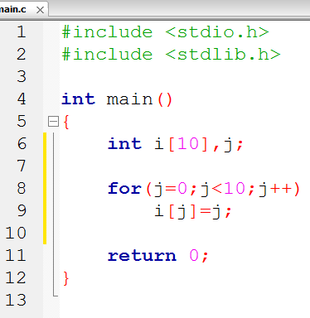
One Dimensional Array….

Slide 8
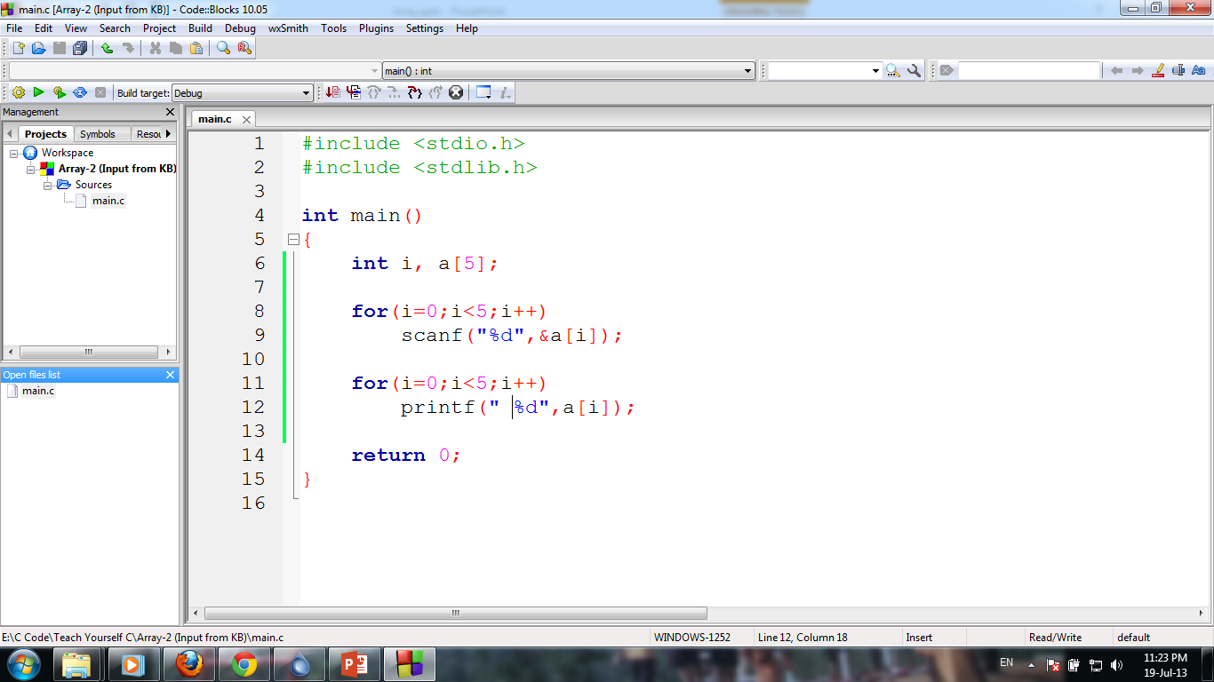
Array…. Input from KB

Slide 9


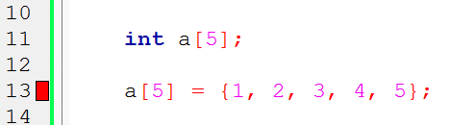
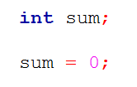
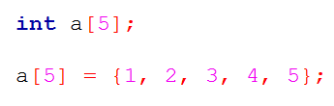
Initialize Arrays
Variable Initialization
Array Initialization

Slide 10
Be aware!
Bounds checking
Single element access
Copy a array to another

Slide 11
Two – Dimensional Array
A two dimensional array is an array of one dimensional arrays and most easily thought of in row, column format.
type array_name [row][column];
int number [5][3];

Slide 12
Problems
Assign random numbers into an array.[ Hint: rand() ]
Calculate the sum of an array elements.
Calculate the sum of all prime numbers in an array of integers.
Search an element from an array.
Find the most frequent element in an array.
Find the MAX/MIN element in an array.
Find the second MAX/MIN element in an array.
Sort elements of an array in ascending/descending order.
Add two 2-D matrix of size m×n and display their summation.

Slide 13
Quizzes
What is array?
Array is an ordered collection of the different type of elements which are stored in contiguous memory locations.
Array is an ordered collection of the same type of elements which are stored in distant memory locations.
Array is an unordered collection of the same type of elements which are stored in contiguous memory locations.
Array is an ordered collection of the same type of elements which are stored in contiguous memory locations.

Slide 14
Quizzes
Array index starts from?
0
-1
1
Value of first element

Slide 15
Quizzes
Index of the last element of an array is ?
n+1
n-1
n
n/2

Slide 16
Quizzes
Which of the following correctly declares an array?
int anarray[10];
int anarray;
anarray{10};
array anarray[10];

Slide 17
Quizzes
Which of the following is a two-dimensional array?
int anarray[10][20];
int anarray[200];
anarray{10}{20};
array anarray[10][20];

Slide 18
Short Questions
If an array is dclared as,int a[7],what is its size in the memory?
28 Bytes

Slide 19
Short Questions
What is the output of the following program?
int a[6]={2,7,3,1,5,9};
printf(“%d”,a[5]+6);
15

Slide 20
Short Questions
What is the output of the following program?
int arr[5]= {5,7,3,1,2};
arr[2]=arr[1];
arr[1]=arr[3];
arr[2]=arr[2]+arr[3];
printf("%d\t%d",arr[1],arr[2]);
1 8

